Slide 1


INSTITUTE OF AERONAUTICAL ENGINEERING
Prototype and Design Building
COURSE CODE-ACSD12
BY
STUDENT NAME- G.VENU KUMAR
ROLL NUMBER-23951A66P7
BRANCH-CSE(AI&ML)
INSTITUTE OF AERONAUTICAL ENGINEERING
DUNDIGAL, HYDERABAD-500 043, TELANGANA,INDIA.

Slide 2

Cooking Up Innovation: How AI and Web Technologies Whip Up Custom Recipes!

Slide 3


Introduction to Recipe Generators
Recipe generators are innovative tools that utilize technology to create customized recipes.
They allow users to input specific ingredients they have on hand, enhancing culinary creativity.
This presentation will explore the integration of web technologies and AI in developing such a tool.

Slide 4


Importance of Custom Recipe Generators
Custom recipe generators reduce food waste by maximizing the use of available ingredients.
They cater to dietary restrictions and preferences, promoting inclusivity in meal planning.
By offering personalized recipes, they enhance user engagement and satisfaction

Slide 5


Role of Artificial Intelligence
Web technologies encompass a range of tools and frameworks for building interactive applications.
Key technologies include HTML, CSS, JavaScript, and APIs that facilitate data exchange.
The combination of these technologies allows for dynamic user experiences in recipe generation.

Slide 6
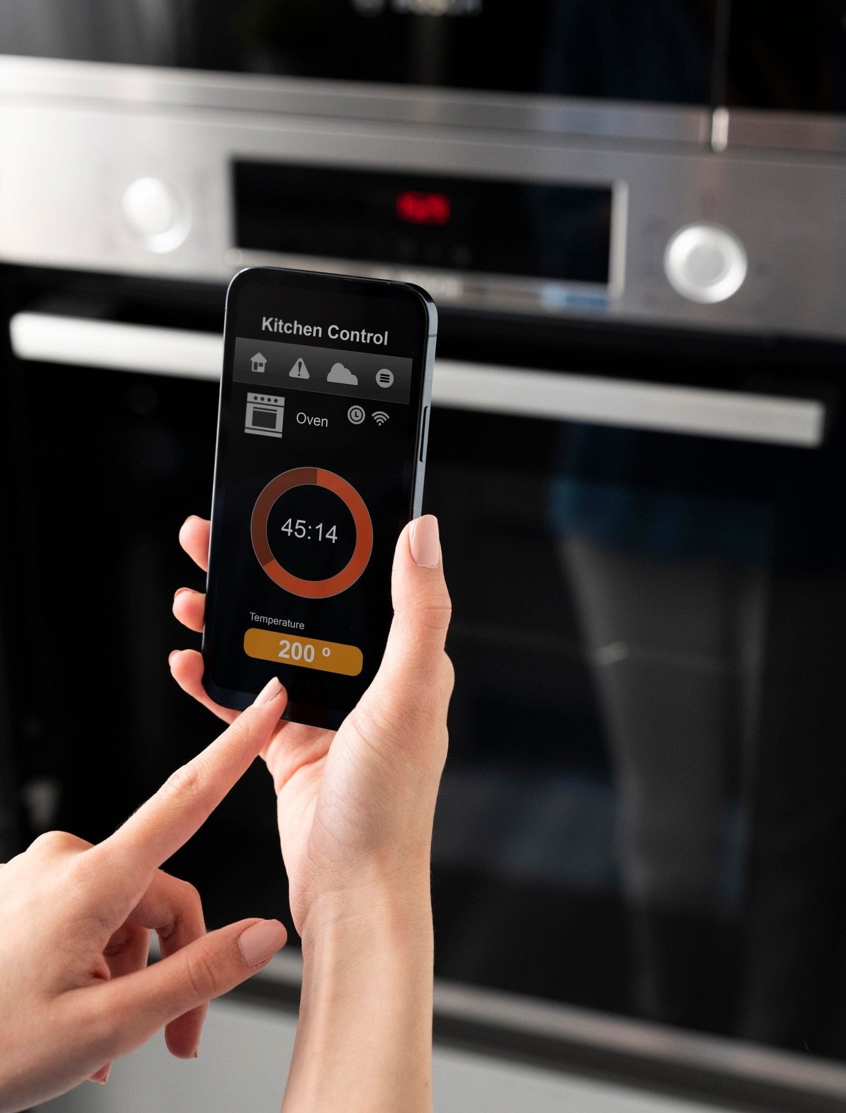
User Input Mechanism
Web technologies encompass a range of tools and frameworks for building interactive applications.
Key technologies include HTML, CSS, JavaScript, and APIs that facilitate data exchange.
The combination of these technologies allows for dynamic user experiences in recipe generation.

Slide 7

Web Technologies in Recipe Creation
Web technologies encompass a range of tools and frameworks for building interactive applications.
Key technologies include HTML, CSS, JavaScript, and APIs that facilitate data exchange.
The combination of these technologies allows for dynamic user experiences in recipe generation.

Slide 8
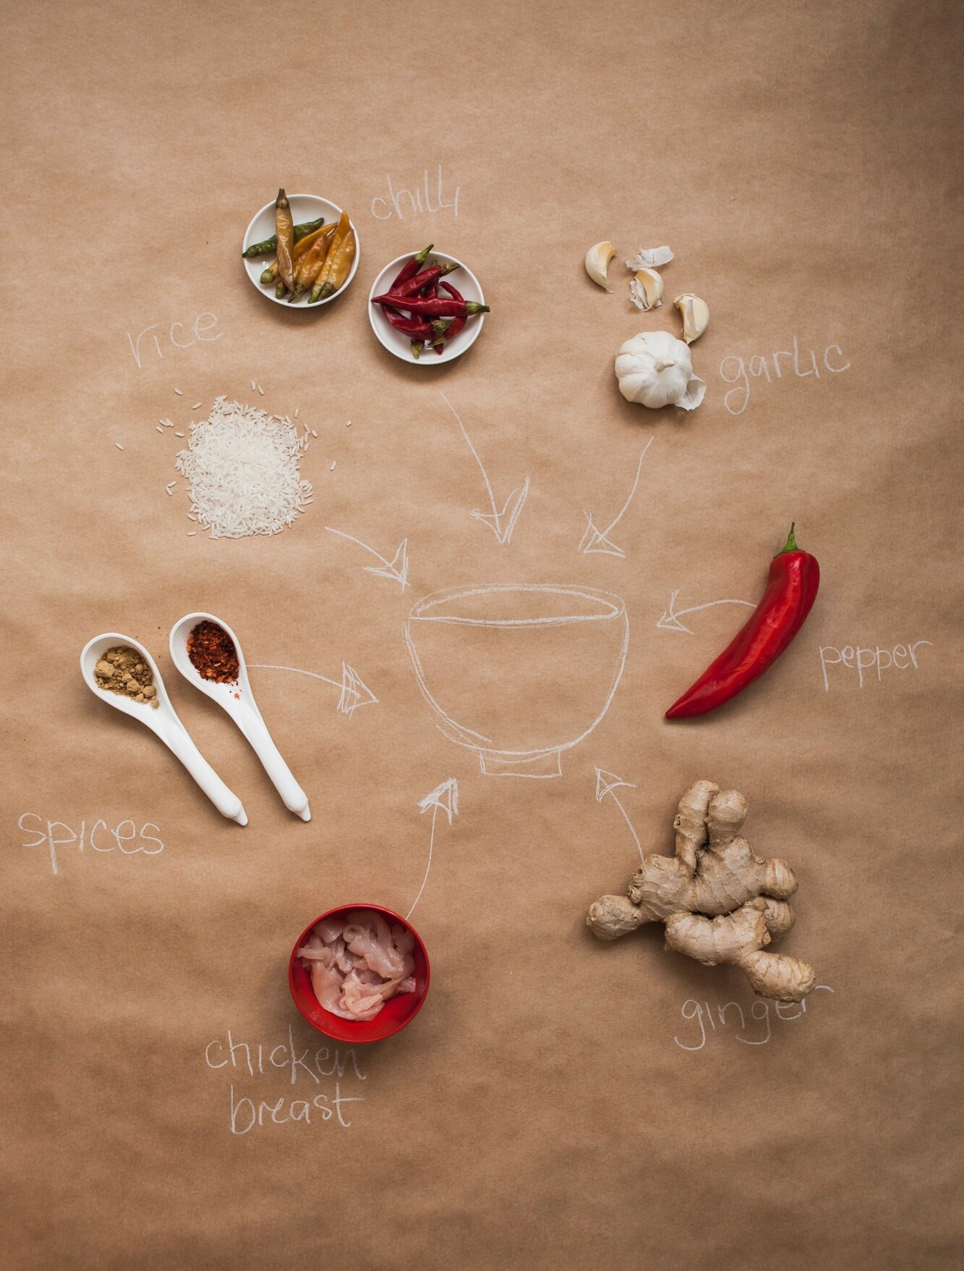
Recipe Generation Process
Web technologies encompass a range of tools and frameworks for building interactive applications.
Key technologies include HTML, CSS, JavaScript, and APIs that facilitate data exchange.
The combination of these technologies allows for dynamic user experiences in recipe generation.

Slide 9
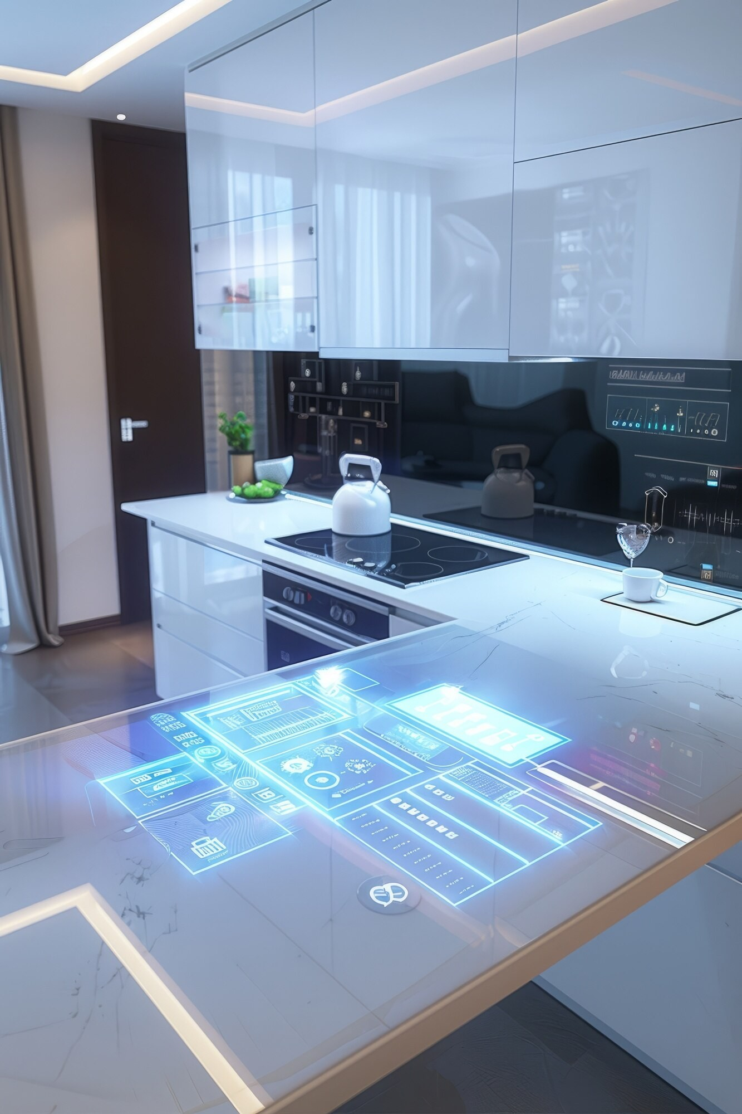
The Future Trends in Recipe Generators
Web technologies encompass a range of tools and frameworks for building interactive applications.
Key technologies include HTML, CSS, JavaScript, and APIs that facilitate data exchange.
The combination of these technologies allows for dynamic user experiences in recipe generation.

Slide 10

Conclusion : A Recipe for Success
In conclusion, the fusion of AI and web technologies is not just transforming how we cook; it’s redeﬁning the entire culinary landscape. Embrace these innovations, and let them inspire your next culinary adventure!
They not only support users in meal preparation
but also promote sustainability.

Slide 11

Thanks!

